Slide 1
Two Port Networks
Chapter 19

Slide 2
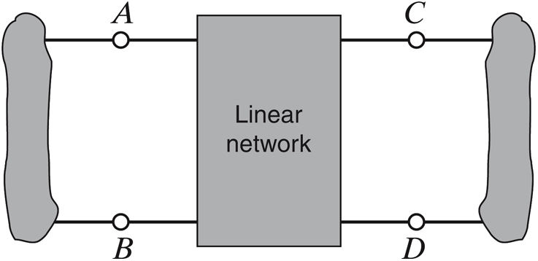

TWO-PORT NETWORKS
In many situations one is not interested in the internal organization of a
network. A description relating input and output variables may be sufficient
A two-port model is a description of a network that relates voltages and currents
at two pairs of terminals
LEARNING GOALS
Study the basic types of two-port models
Admittance parameters
Impedance parameters
Hybrid parameters
Transmission parameters
Understand how to convert one model into another

Slide 3
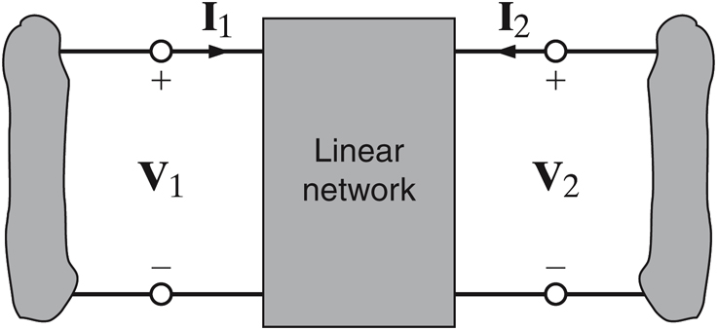
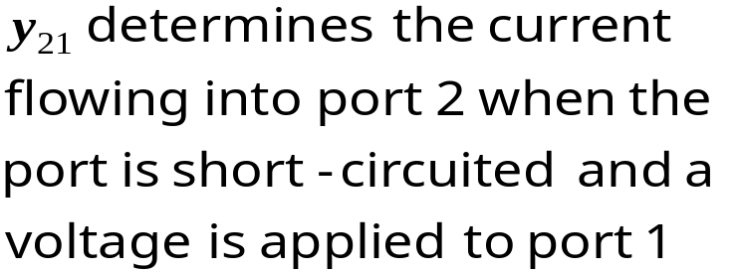
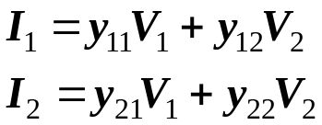
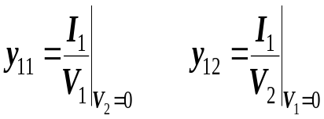
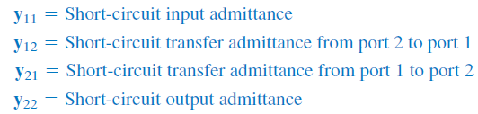
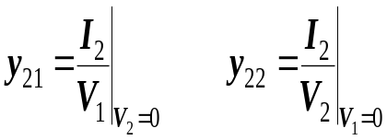
ADMITTANCE PARAMETERS
The admittance parameters describe the currents in terms of the voltages
The first subindex identifies
the output port. The second
the input port.
The computation of the parameters follows directly from the definition

Slide 4
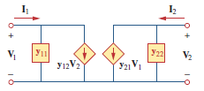
ADMITTANCE PARAMETERS (2)

Slide 5
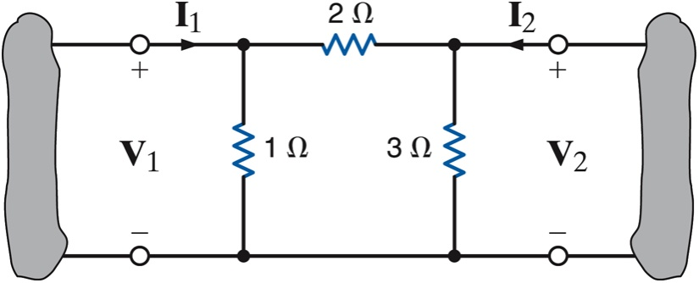
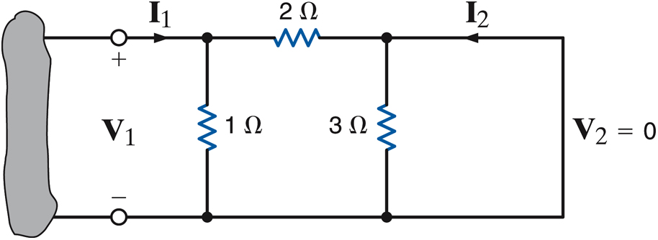
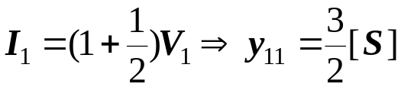

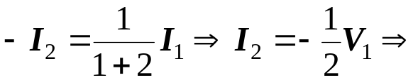
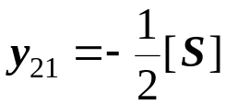
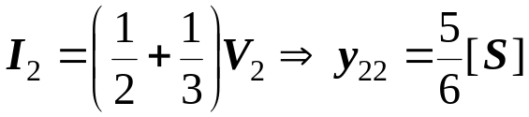
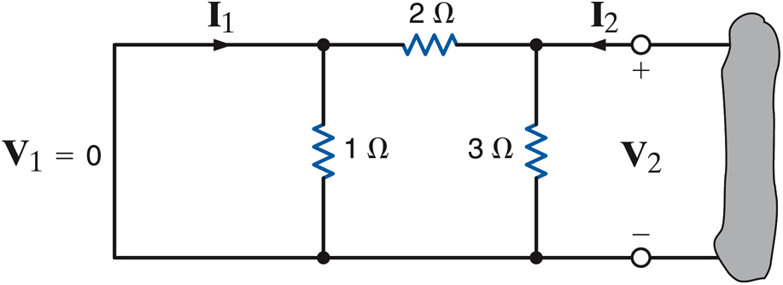
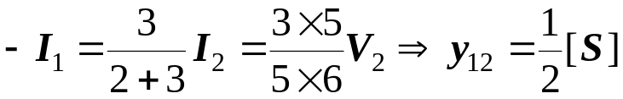
LEARNING EXAMPLE
Find the admittance parameters for the network
Next we show one use of this model

Slide 6
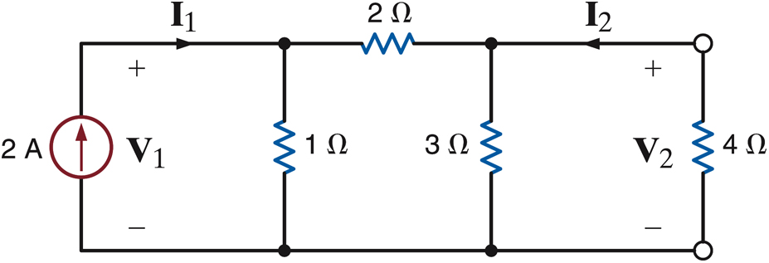
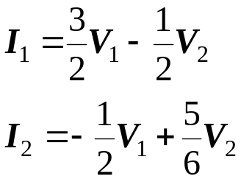
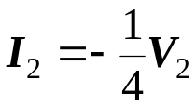

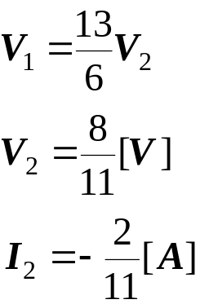
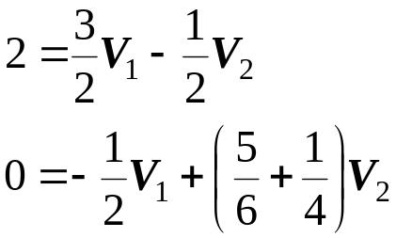
An application of the admittance parameters
Determine the current through the
4 Ohm resistor
The model plus the conditions at the
ports are sufficient to determine the
other variables.

Slide 7
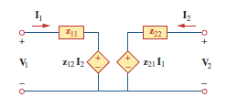
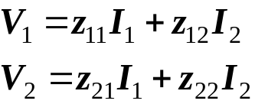
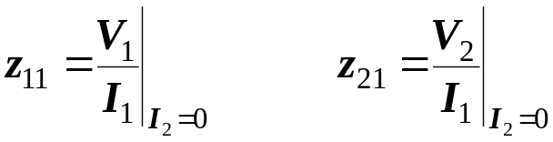

IMPEDANCE PARAMETERS
The Impedance parameters describe the voltages in terms of the currents
The ‘z parameters’ can be derived in a manner similar to the Y parameters

Slide 8
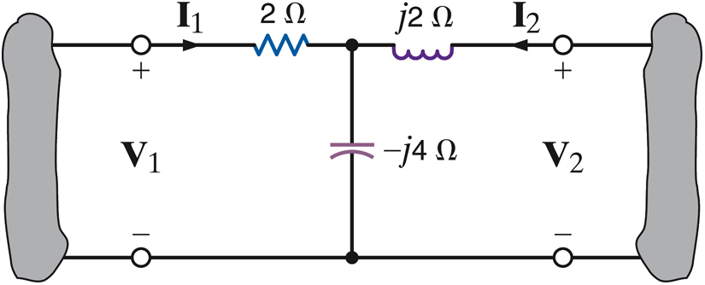
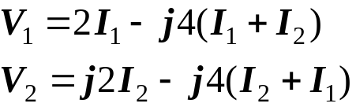
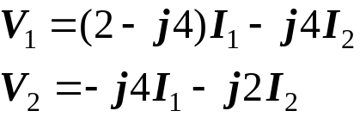
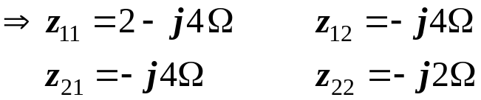
LEARNING EXAMPLE
Find the Z parameters
Write the loop equations
rearranging

Slide 9
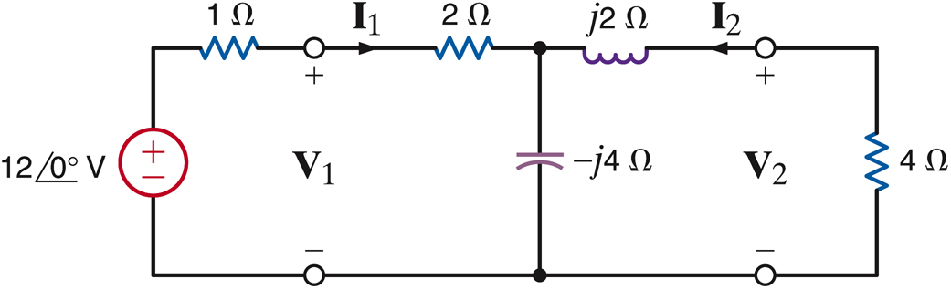








LEARNING EXAMPLE
Use the Z parameters to find the current through the 4 Ohm
resistor
Output port constraint
Input port constraint

Slide 10
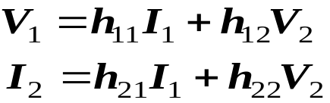
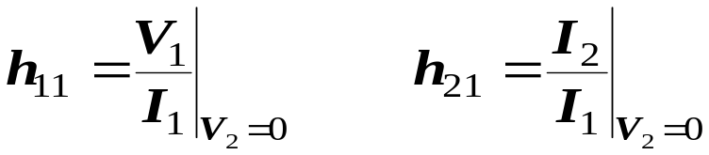
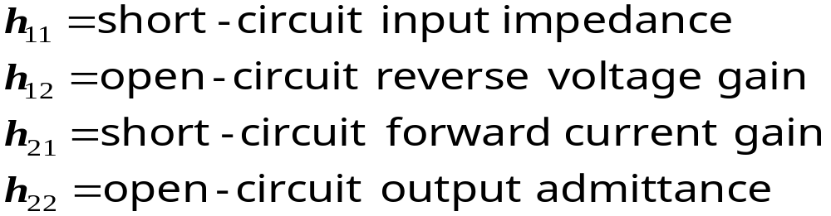
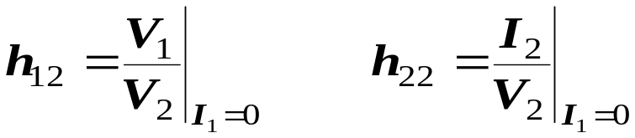
HYBRID PARAMETERS
The network contains NO independent sources
These parameters are very common in modeling transistors

Slide 11


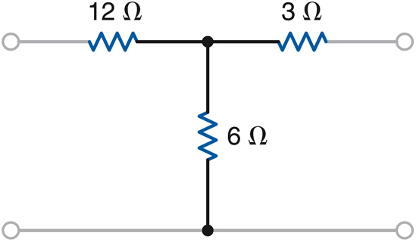




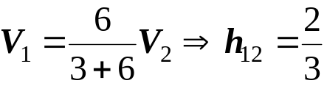
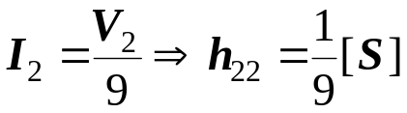
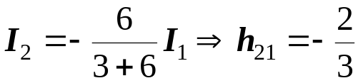
LEARNING EXAMPLE
Find the hybrid parameters for the network

Slide 12
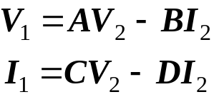
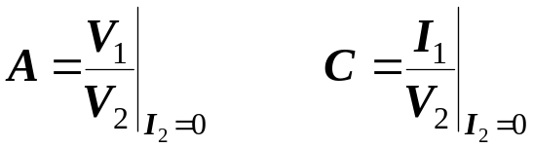
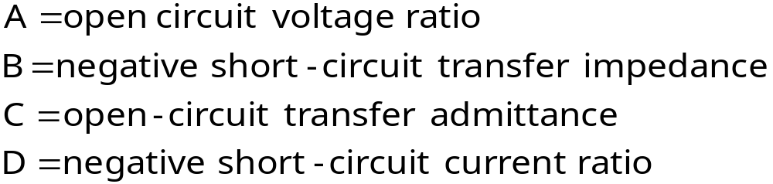
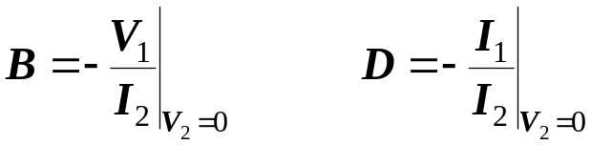
TRANSMISSION PARAMETERS
ABCD parameters
The network contains NO independent sources

Slide 13
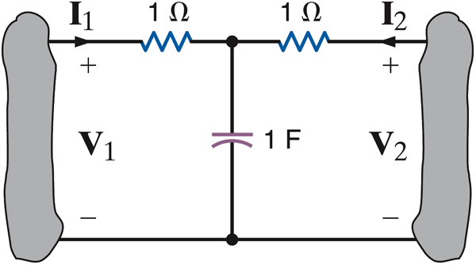


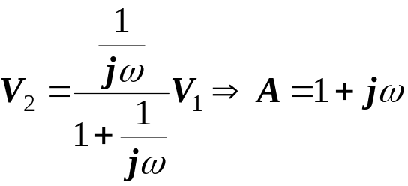
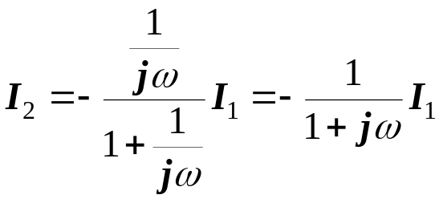

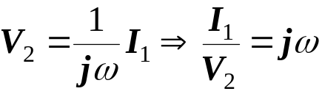
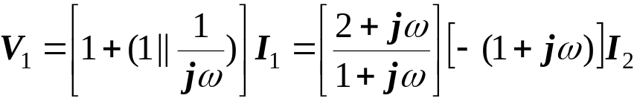

LEARNING EXAMPLE
Determine the transmission parameters

Slide 14
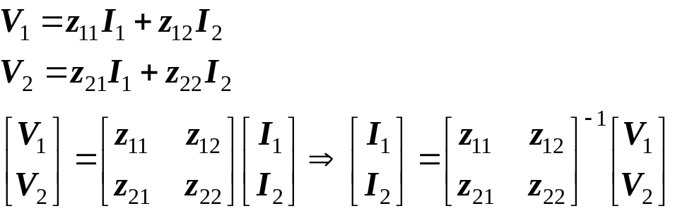
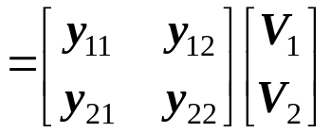
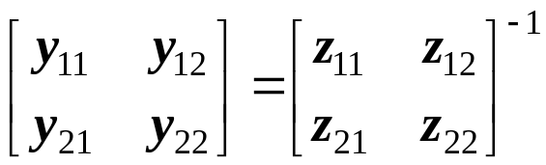
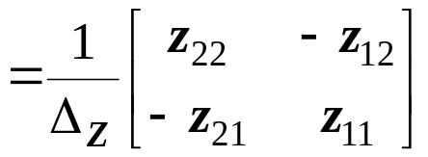


PARAMETER CONVERSIONS
If all parameters exist, they can be related by conventional algebraic manipulations.
As an example consider the relationship between Z and Y parameters

Slide 15


Slide 16



INTERCONNECTION OF TWO-PORTS
Interconnections permit the description of complex systems in terms of simpler
components or subsystems
The basic interconnections to be considered are: parallel, series and cascade
PARALLEL: Voltages are the same.
Current of interconnection
is the sum of currents
The rules used to derive models
for interconnection assume that
each subsystem behaves in the
same manner before and after
the interconnection
SERIES: Currents are the same.
Voltage of interconnection is the sum
of voltages
CASCADE:
Output of first subsystem
acts as input for the
second

Slide 17






Parallel Interconnection: Description Using Y Parameters

Slide 18



Series interconnection using Z parameters
SERIES: Currents are the same.
Voltage of interconnection is the sum
of voltages

Slide 19







Cascade connection using transmission parameters
CASCADE:
Output of first subsystem
acts as input for the
second
Matrix multiplication does not commute.
Order of the interconnection is important

Slide 20









LEARNING EXAMPLE
Find the Y parameters for the network

Slide 21




LEARNING EXAMPLE
Find the Z parameters of the network
Network A
Use direct method,
or given the Y parameters transform to Z
… or decompose the network in a series
connection of simpler networks
Network B

Slide 22







LEARNING EXAMPLE
Find the transmission parameters
By splitting the 2-Ohm resistor,
the network can be viewed as the
cascade connection of two identical
networks
Two-Ports

